Slide 1

The Concern Related
Aviation Fuel and Flight Safety

Slide 2
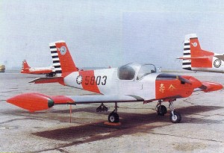
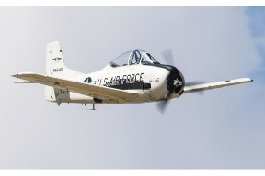
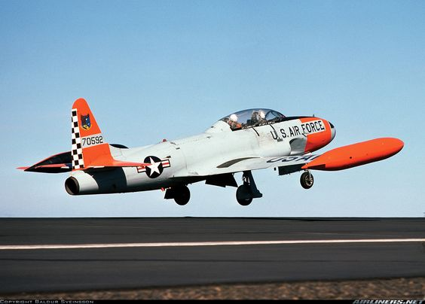
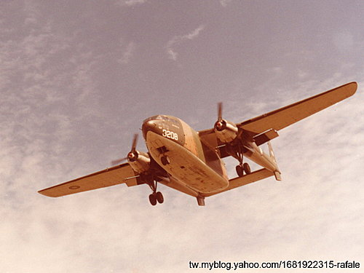
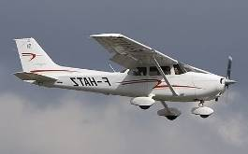

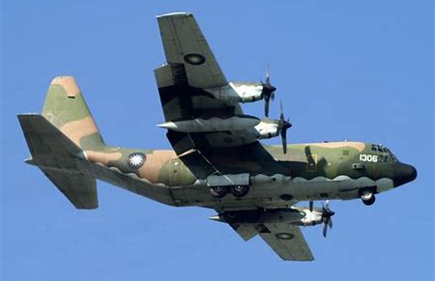
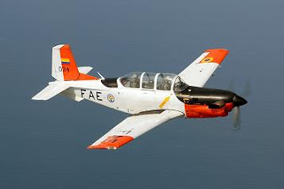
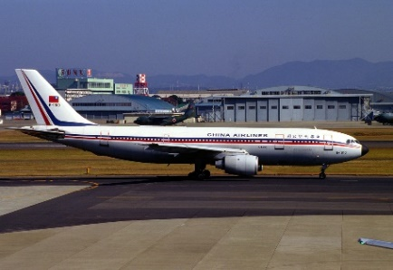

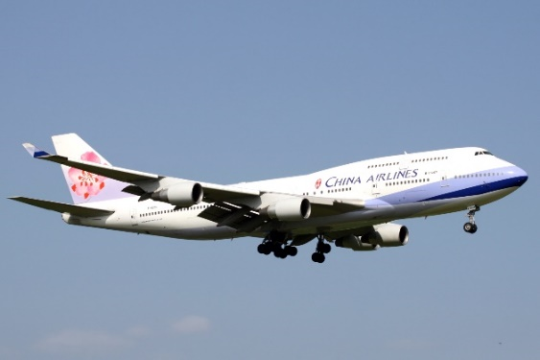


Cessna
PL-1 6:30
T-28 72:00
T-33 116:50
C-119 2390:40
1312
CAP T-34 0:20
A300-B4 1258:02
C-130H 757:05
1. 空軍官校第 53 期畢業
2. Certified CRM LOFT Facilitator, Lufthansa Technik.
3. 中華航空 AB6-600R 航路 & 模擬機 教師機師
4. 中華航空 AB6-600R 訓練組長
5. 民航局 AB6-600R 委任檢定考試官
6. 中華航空 航務處 標考部 副經理 經理^{代}
7. 中華航空 B747—400 正機師
8. 曾飛機種 : PL-1, T-28, T-33, C-119, C-130H,
A300-B4, AB6-600R, B747-400.
9. 飛行 總時間 : 1971-06-01 ~~ 2011-09-25
20497:05 hrs.
10. E-mail: tpytom2012@gmail.com
AB6-600R 5204:03
B747-400 10690:55
B747--400 機長
鄧培殷

Slide 3
The Concern Related Aviation Fuel and Flight Safety
Air Traffic Control System & New Flightradar24 Tracker Service ( 04 — 14)
Aviation Fuel & Cases Review ( 15 — 22)
What Is The Main Factor May Affect Maximum Flight Time ( 23 — 33)
Better Understanding Aviation Fuel Affected Flight Safety ( 34 — 49)
What Do Pilots Do Before The Flight ( 50 — 56)
How To Protect The Minimum Fuel and The Final Reserve Fuel ( 57 — 65)
In-Flight Fuel Management : Normal Procedures
Abnormal Procedures
Aviation biofuel ( ECO ^{flying is ongoing} ) ( 66 — 79)
Conclusion ( 80 — 84)
Q & A ( — 85)
The Contains :

Slide 4



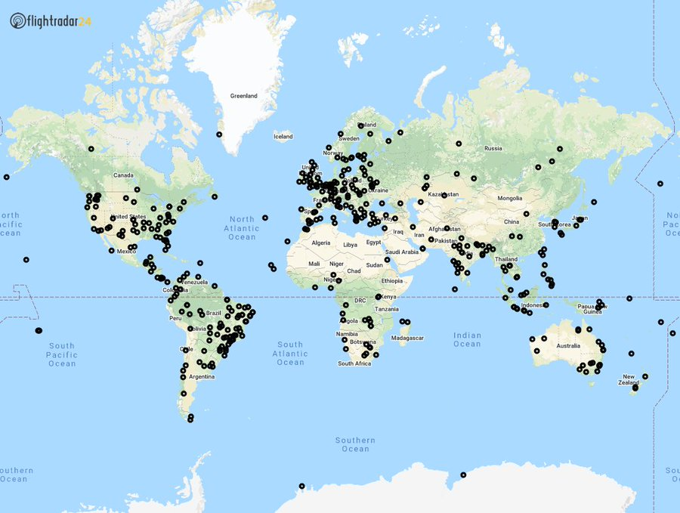
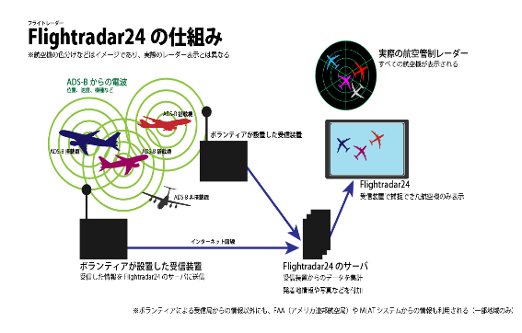
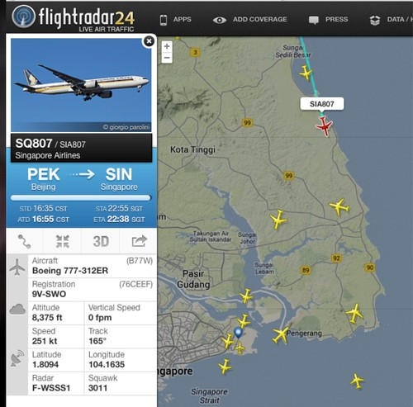
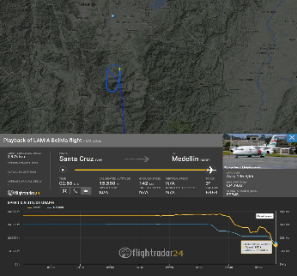
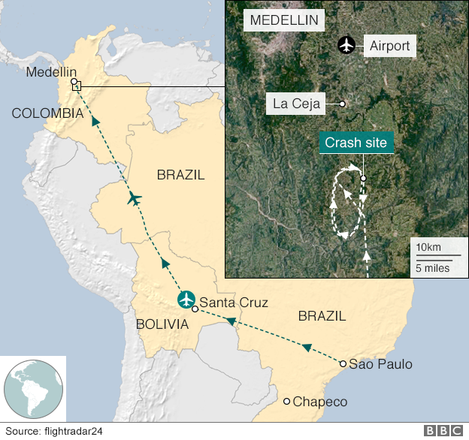
Air Traffic Control System And Service
New Flightradar24 ADS-B Receivers
Activated in July 2020
Automatic Dependent Surveillance
- Broadcast (ADS-B) And Tracker (24x7)
SEP 09, 2020 UTC 15:53 ( 2353L )
DATA SOURCE VIEW GLOBA
ADS-B 806 11,171
SATELLITE 2 126
MLAT 1 517
RADAR 0 749
FLARM 0 900
ESTIMATED 36 184
TOTAL 845 13,647
ADS-B receiver
4

Slide 5
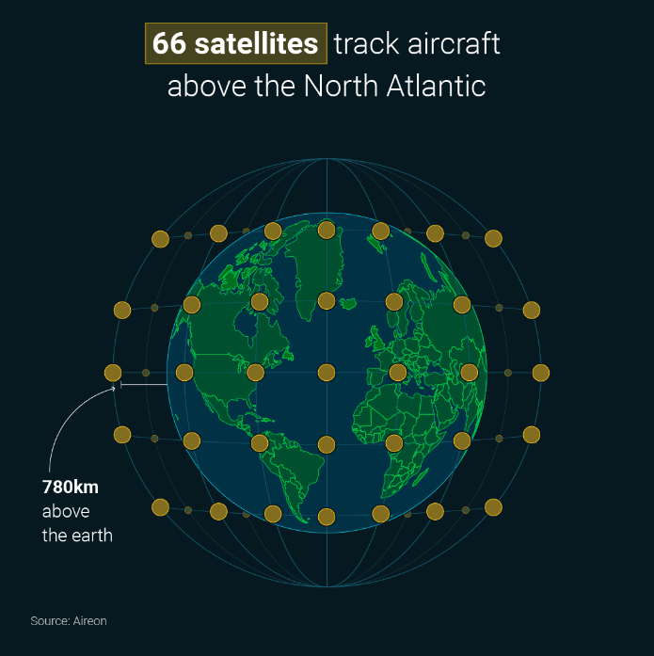
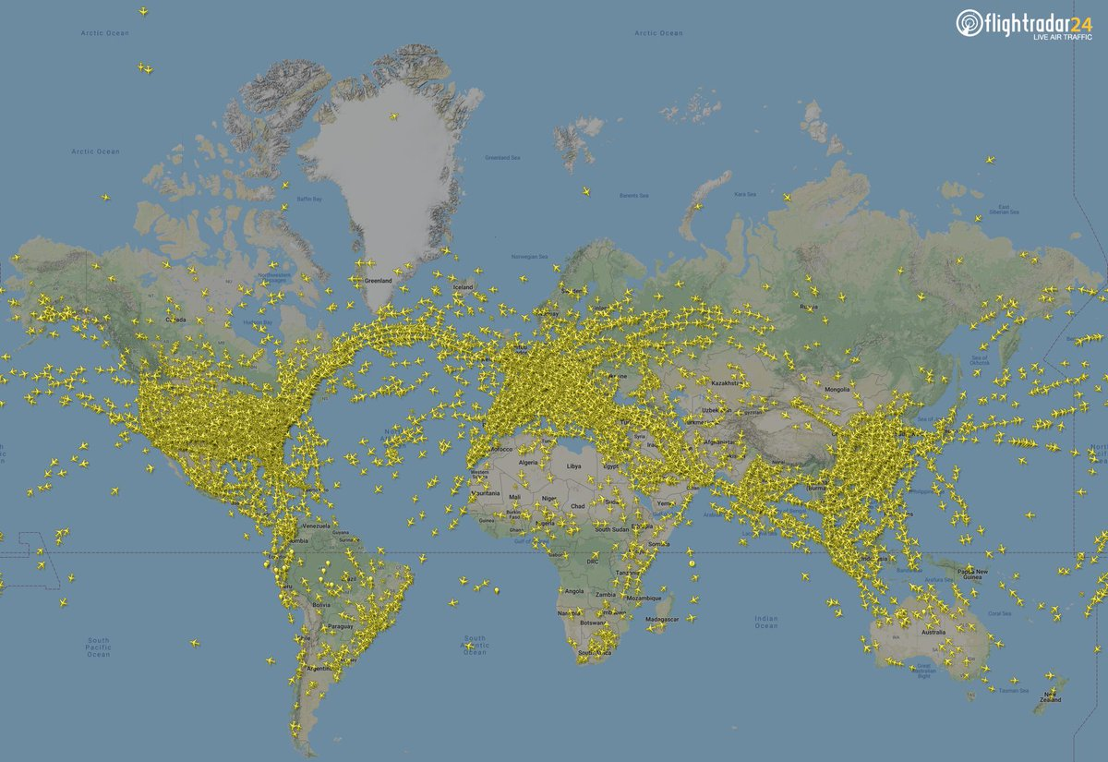

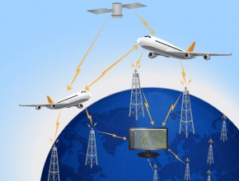
Flightradar24x7
Flightradar24 is a global flight tracking service that provides you with real - time information about thousands of aircraft around the world .
Flightradar24 tracks 180,000 + flights, from 1,200 + airlines, flying to or from
4,000 + airports around the world in real time.
從1903年萊特兄弟發明飛機至今已有117年，對於現代人來說，
搭飛機到國外出差度假已是習以為常，其實在六十多年前，
空中仍屬戰機的天下，如今每天超過八百萬人透過空中交通旅行
，讓這一切成為理所當然的，正是噴射客機的發明………
A picture is worth a thousand words.

Slide 6
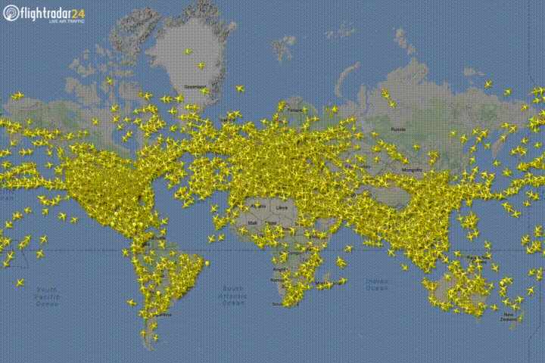
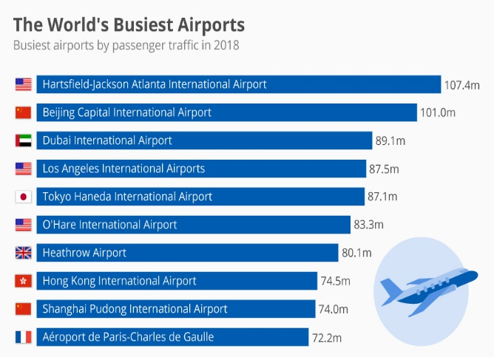
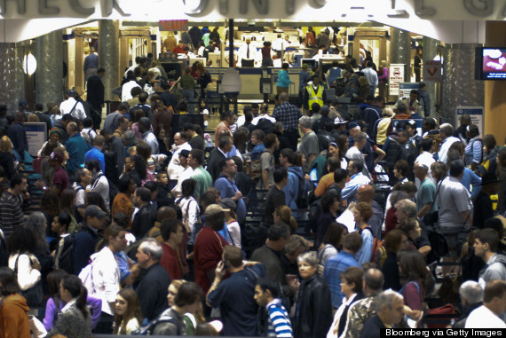
It is all because of Demand & supply.... And It is the trend of profit....
1. Atlanta
7
10
5. Haneda
4. Los Angeles
5
2. Beijing
4
3
6. Chicago
6
1
9. Shanghai
2
10. Paris
9
8. Hong kong
7. Heathrow
8
3. Dubai
Global economic system is activated and flying…..
Hartsfield-Jackson Atlanta International Airport
Every year : passengers 95.5 million
takeoffs and landings 930,000
World GDP is flying !!!
Dubai's new airport is set to take over the title.
6

Slide 7
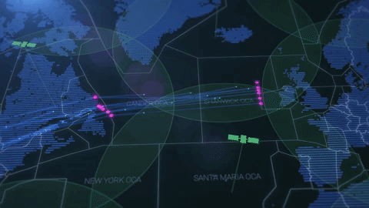
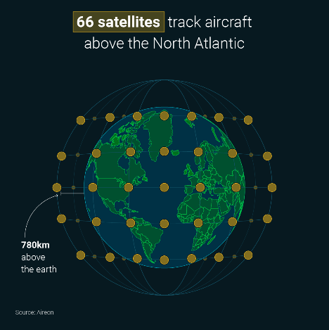



Space-based ADS-B is transform the North Atlantic
Aireon has deployed a space-based air traffic surveillance system
for Automatic Dependent Surveillance-Broadcast (ADS-B)
equipped aircraft throughout the entire globe.
Providing most efficient flight trajectories
By increasing flight efficiency, the introduction of space-based ADS-B will reduce airlines’ fuel burn and CO2 emissions.
Quick intervention in seconds
80% without speed restriction
Reduce the minimum distances
76% reduction in safety risk
fuel savings & emissions savings
fuel price of USD$650 per tonne
$153 and $312
Safety
Service transformation
Environment and
fuel savings
Aireon: From Concept to Operation
https://youtu.be/vktXmTdiPMs 3’:49”
https://www.bing.com/videos/search?q=North+Atlintic+skies+(2014)&docid=608035543683301950&mid=433D51396B3CA49B99FA433D51396B3CA49B99FA&view=detail&FORM=VIRE
1’:51”

Slide 8
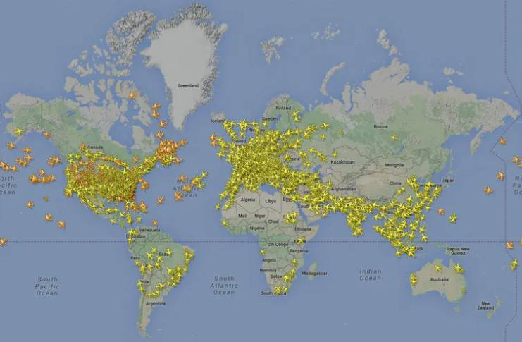
This time lapse shows traffic over the North Atlantic
from 0000 UTC to 2359 UTC on 6 May 2020.
Learn More about a picture is worth a thousand words.
An example of eastbound traffic flowing along the North Atlantic Tracks (NAT).
7. Heathrow
※※※ Please allow me to guide everyone into the cockpit in the way of simulation teaching to
experience how the flight crew controls the various tasks of the flight……..
live from the flight desk –5’:21”
https://www.flightradar24.com/blog/over-the-ocean-24-hours-of-transatlantic-flight/
x3
8

Slide 9
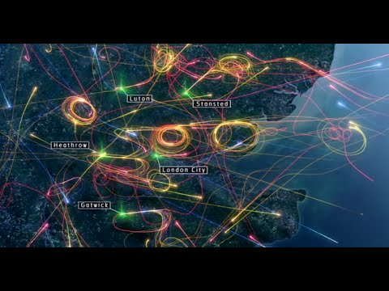
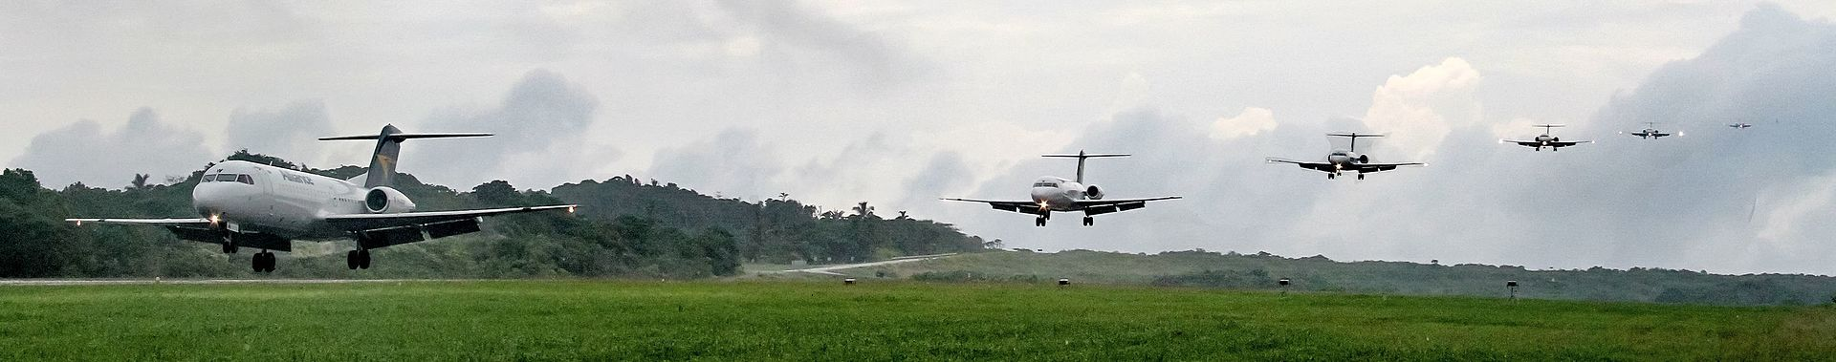
What does a day of bad weather look like?
14 February 2014
7. Heathrow
CS-5070 Clear to land, Runway is clear ! For passengers, it is the beginning of a beautiful journey ...
Dealing with bad weather is one of the most difficult things for air traffic controllers to manage. Its unpredictable nature means aircraft aren’t able to fly their usual routes, resulting in unusual flight patterns that add hugely to the complexity of the airspace and the workload for each controller.
We’ve taken a day’s worth of flight data from 14 February 2014 to try and show you. Why 14 February? Far from being romantic, it remains one of the worst days of weather in the UK in recent years. Heavy rain and severe gales lashed much of the country, with gusts of 60–70mph widely recorded, and even 80–90mph along the coasts. In short, very difficult conditions to fly in.
https://www.youtube.com/watch?v=brX_VhOU3qQ&t=71s
2’:19”

Slide 10

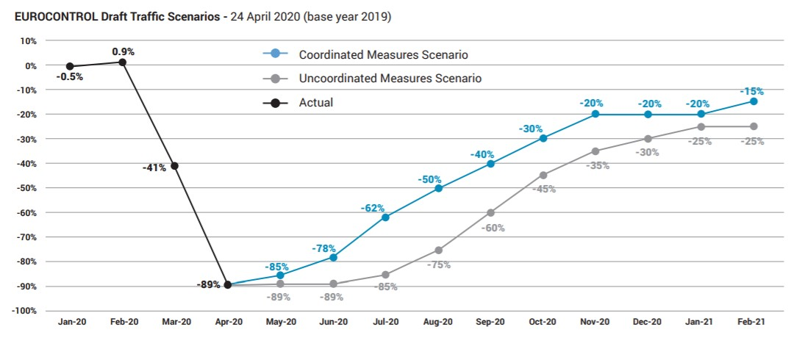
✽ Aviation industry should knowing how to survive amidst
being impacted by covid-19.
Xinhua | Jun. 28, 2020
Headquarters of
EUROCONTROL
in Brussels
Based on one set of regulations on departure and
another set when the flight arrives in another state
因應新冠肺炎疫情，疾管署持續加強疫情監測與邊境管制措施，關乎兩地互通友好安全放飛協議的達成,……
例如:天合聯盟（SkyTeam）… 或 普篩 ? 全篩………
2024
2021
…. ↗↗ Toward Recorcey
"V-Shaped"
"U-Shaped"
From Pandemic …. ↗↗
“L-shaped”
an increase of 1,222
week – on-- week
Jul.17/29 weeks
> 15,818
Apr.12
https://www.bing.com/search?q=Euro+control&qs=n&form=QBRE&sp=-1&pq=euro+control&sc=8-12&sk=&cvid=B7112997917C4EB296AD774CAC0B350D

Slide 11
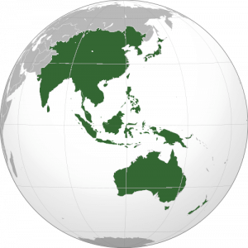
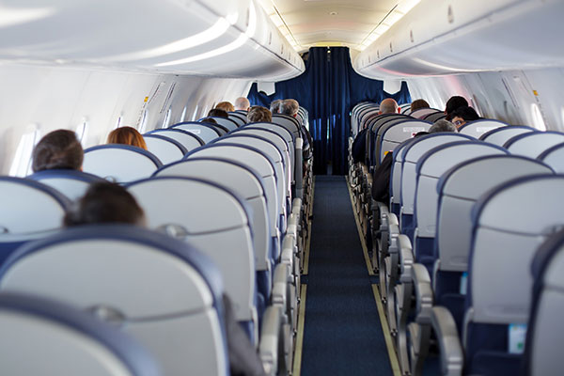
The post-COVID-19 recovery is the key point.
Chinese People Make over 78m Trips
During Dragon Boat Festival Holiday
Passenger on trips : 114,74 million
Xinhua | Jun. 28, 2020
Passenger trips on trains : reached 17.76 million
Passenger trips via waterway : totaled 1.61 million
Vehicles on expressways : around 92.69 million
✽ Passenger trips by civil airlines : An estimated 2.68 million
Passenger road trips : average load factor standing at 69 %
International flights : ………… ↗↗
UA & DA unveiled to take round-trip flights from US to
China each week, 2 → 4 → 8 flights per week…...
e.g.: SFO ↔ PVG ; SEA ↔ PVG ……………
※ Sep 03 : x 8_ 9 →→ PEK
✽ Flight : 1M per year ; 10,000 per day
YOY 2019 : (PLF) 60% - 70% ; NB - SA ………↗↗
✽ Airbus delivers A/C to China:
182 – 122 = 60 ( impacted by covid-19 )

Slide 12
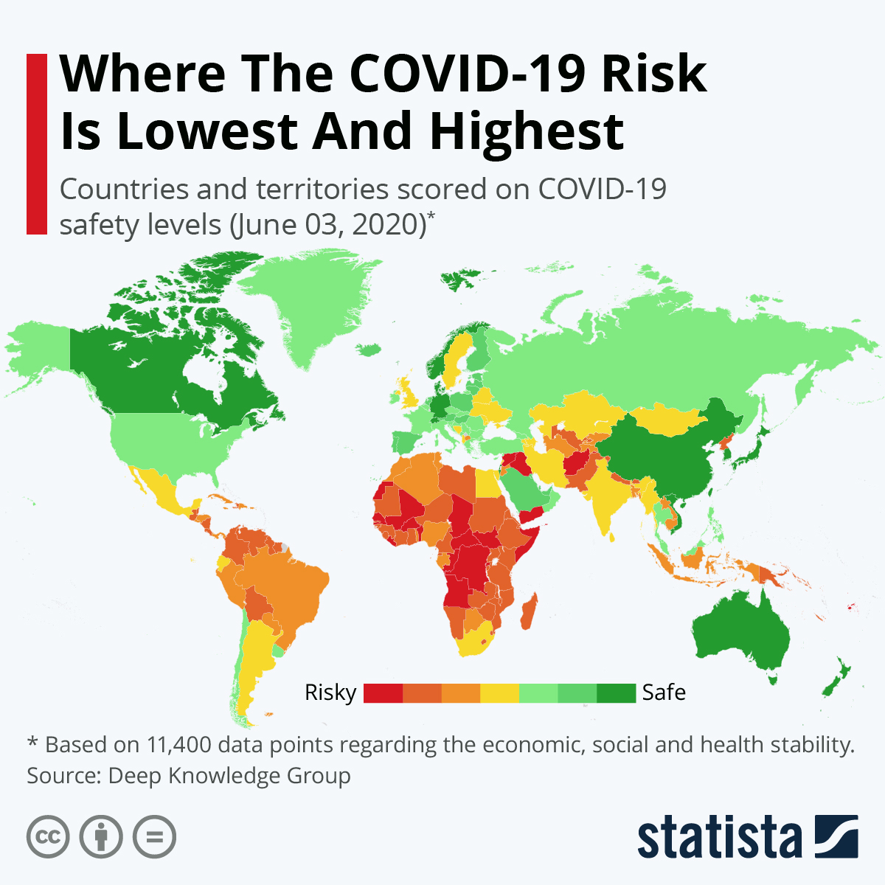
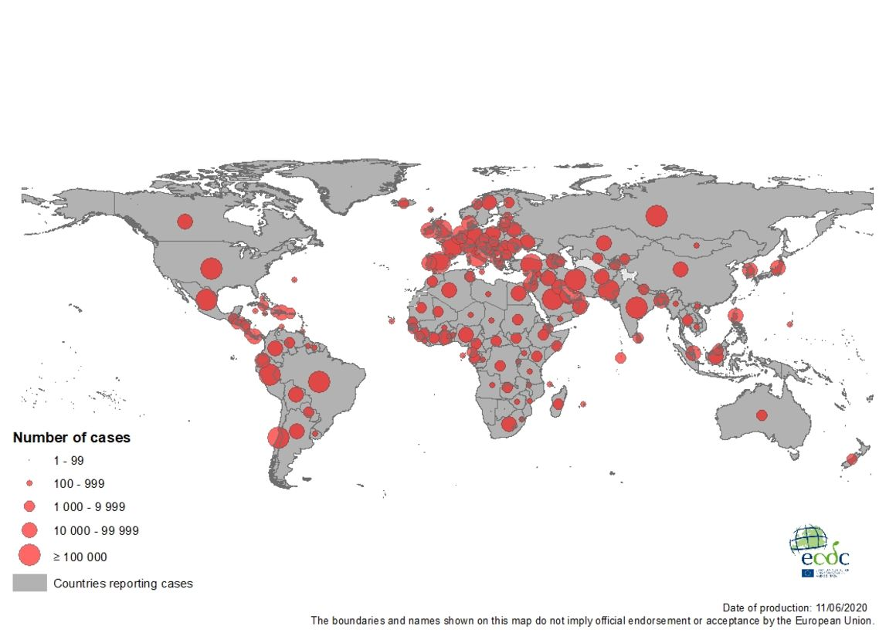
Geographic distribution of COVID-19 cases worldwide,
as of Last updated : SEP 08, 2020, 16:22 GMT
Israel
Germany
68th
58th
Switzerland
00:22 (TPE LCL )
Confirmed : 27,569,305 Recovered : 19,675,763
Deaths : 898,126
Last updated: 2020/09/08 16:22 GMT
Total Cases : 6,493,796
Active Cases : 2,538,564
Total Recovered : 3,760,821
Total Deaths : 193,673
Child : > 338,000
Mali
Sudan
Chad
SEP 09, 2020 UTC 15:53 ( 2353L )
Rwanda
DATA SOURCE VIEW GLOBA
ADS-B 806 11,171
SATELLITE 2 126
MLAT 1 517
RADAR 0 749
FLARM 0 900
ESTIMATED 36 184
TOTAL 845 13,647

Slide 13
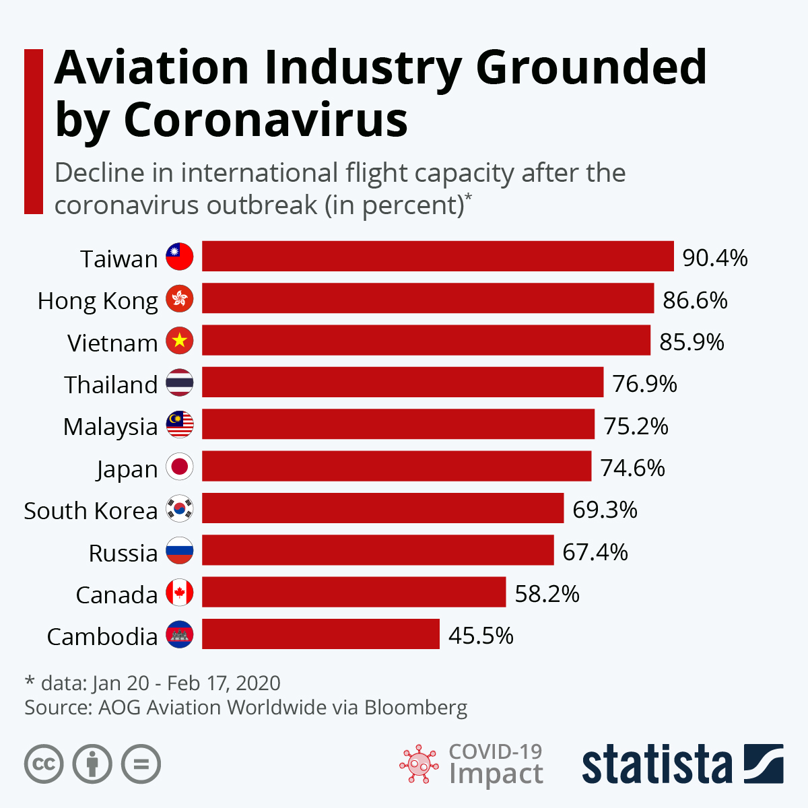

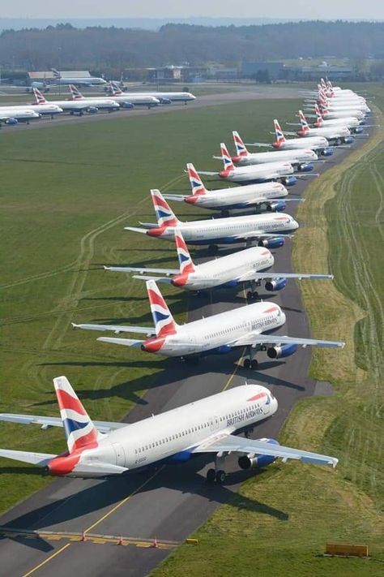
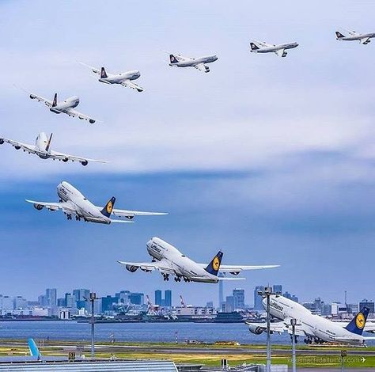
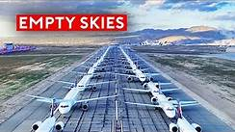
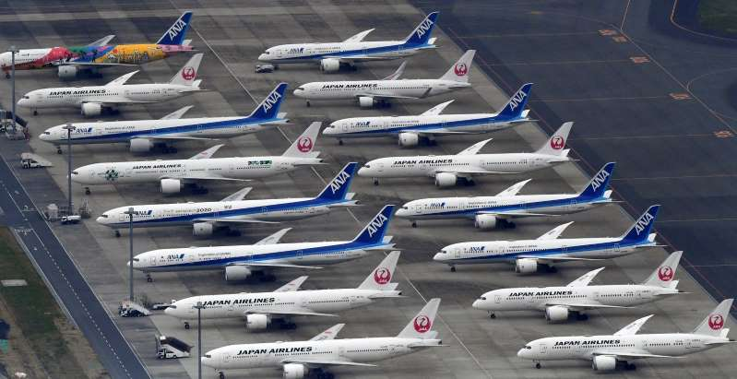
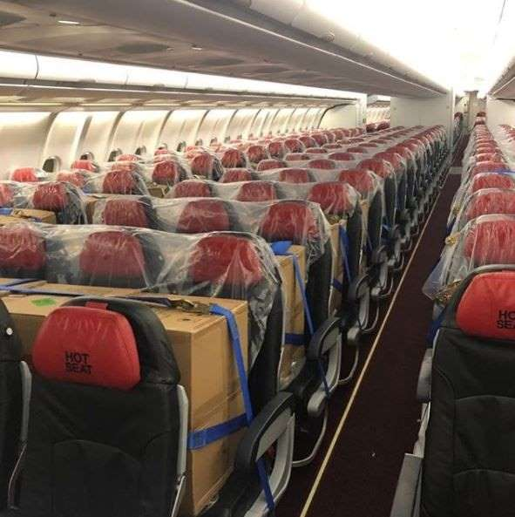
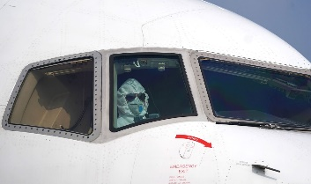
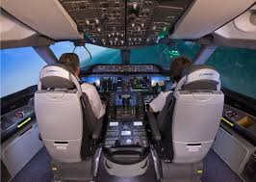
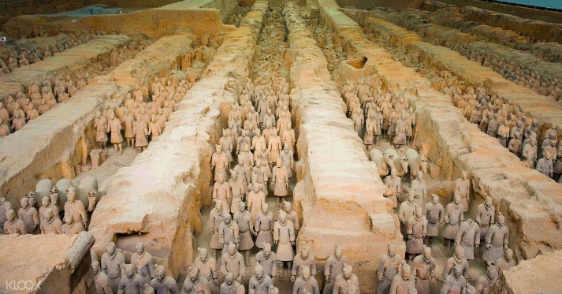


Haneda airport
Dubai airport
受疫情影响,飛機不單單停在那就好,飛機停飛 48 小時以上就要開啟不同階段的 維修程序 . 飛機每 7天 需要打開
電器和液壓系統,以檢查它他們是否正常工作,並啟動發動機,並使其空轉約 20 分鐘,以便對所有組件進行潤滑.
CRM LOFT Simulation Training..….
Online Aviation Courses……….
COVID-19: Aviation’s Fight For Survival 10’: 26”

Slide 14
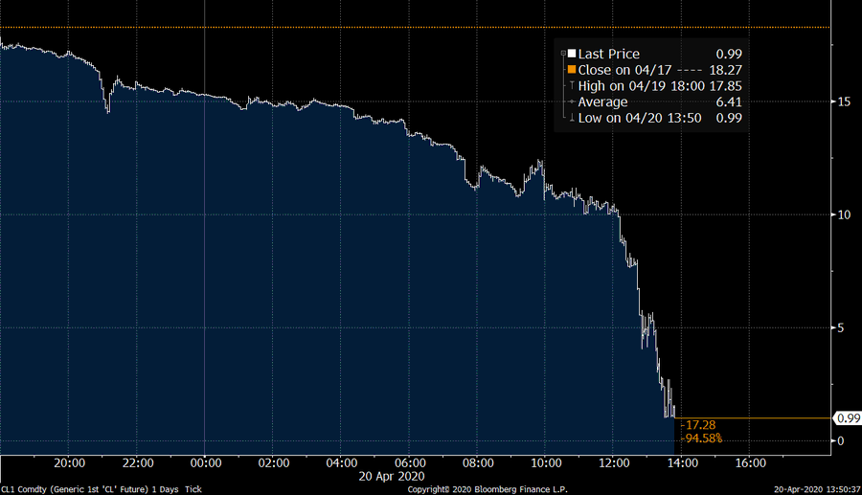
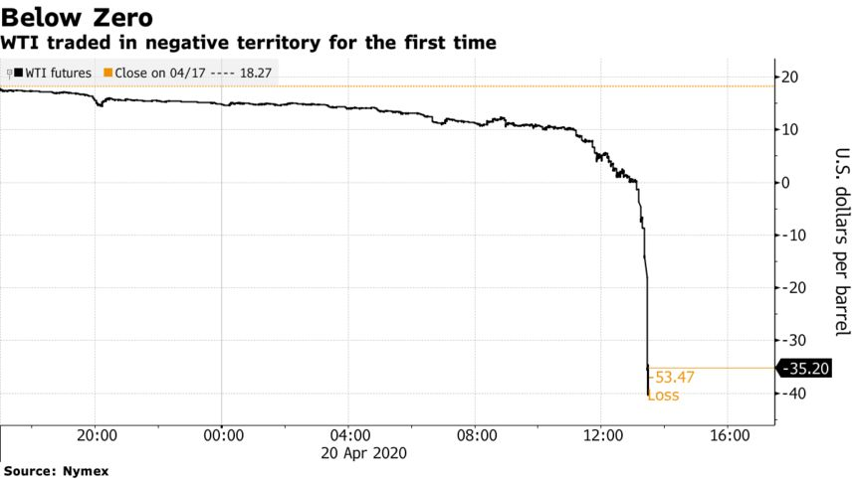

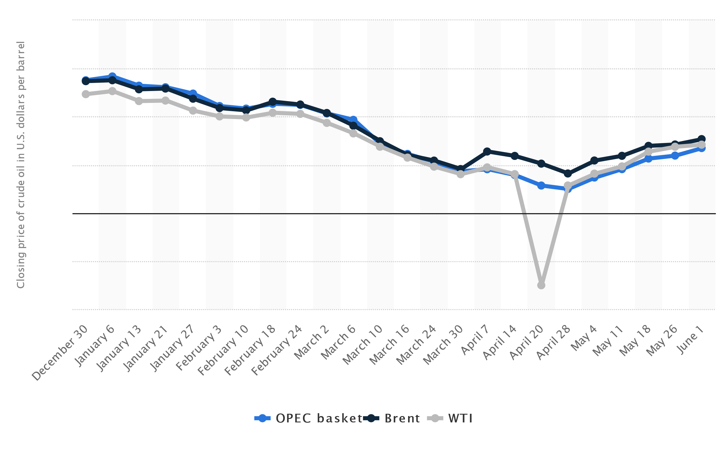

Tracking the fuel price related to COVID-19……...
Oil Plunges Below Zero for First Time in Unprecedented Wipeout ↘
1:51 am APR 21, 2020
BREAKING : Oil drops below $1 a barrel (0.99)
Weekly OPEC basket, Brent and WTI crude
oil prices from December 30, 2019 to
June 1, 2020
(in U.S. dollars per barrel)
- 35.20
Apr 20, 2020
OPEC basket 14.19
Brent 25.57
WTI -37.63
April 17, 2020
Negative oil Prices
• Crude oil prices weekly December 2019 to June 2020
AUG 31, 2020
OPEC basket 46.27
Brent 42.61
WTI 45.28

Slide 15

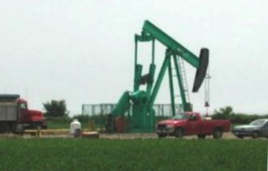
The Concerned Related To Aviation Fuel & Cases Review…
35,000’ x ( -2° C ) = -70° C
Fuel | Flash point | Autoignition temperature
Vegetable oil (canola) | 327 °C (621 °F) | 424 °C (795 °F)^{[9]}
Ethanol (70%) | 16.6 °C (61.9 °F)^{[5]} | 363 °C (685 °F)^{[5]}
Gasoline (petrol) | −43 °C (−45 °F)^{[7]} | 280 °C (536 °F)^{[8]}
Coleman fuel (White Gas) | −4 °C (25 °F)^{[6]} | 215 °C (419 °F)^{[6]}
Biodiesel | >130 °C (266 °F)
Diesel (2-D) | >52 °C (126 °F)^{[7]} | 210 °C (410 °F)^{[8]}
Kerosene | >38–72 °C (100–162 °F) | 220 °C (428 °F)
Jet fuel (A/A-1) | >38 °C (100 °F) | 210 °C (410 °F)
-55 ° C (SAT) Fuel
raw oil
1000’↑ ; ↓ -2° C
OAT (+15° C ) Fuel
Petrol flammable fuels
Diesel combustible fuels,
fuel is loaded before the flight
(the ambient temperature)
The Jet A-1 powering the engines has a freezing point of minus 47C.
How to protect the fuel temperature could not drop toward the freezing point ???

Slide 16
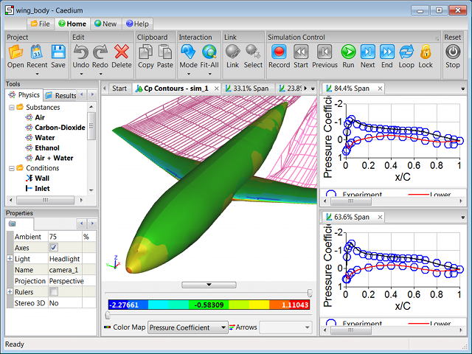
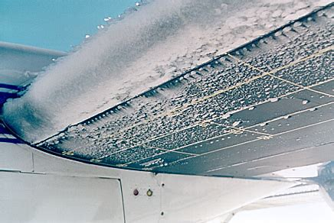
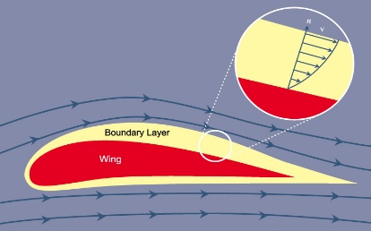
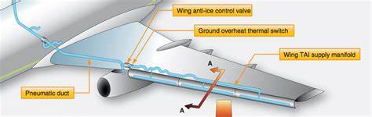
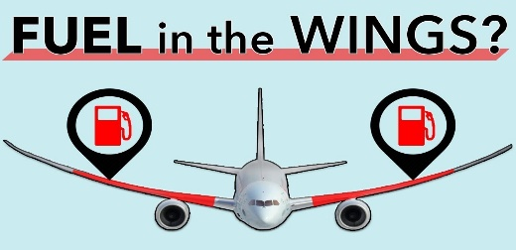
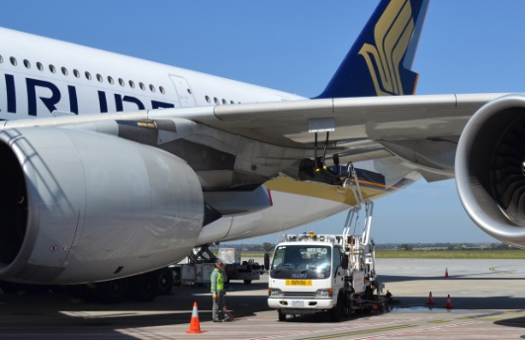
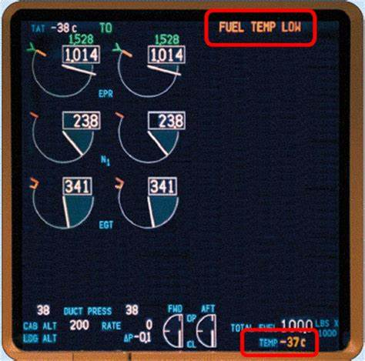
In the air, how to protect the fuel temperature not drop below the freezing point ???
35,000’ x ( -2° C ) = -70° C
-55 ° C (SAT) Fuel
1000’↑ ; ↓ -2° C
Fuel
OAT (+15° C ) Fuel
fuel is loaded before the flight
Flying through cold air
mass at hundreds of
miles per hour ( e.g. A380
LRC M.85 /650 mph )
(the ambient temperature)
Minimum Inflight Tank Fuel Temp Jet A - 40ºC, Jet A1 - 43ºC
-55 ° C (SAT)
The speed of air
over the wings
creates friction
(Alt. x -2 + OAT) + = TAT ( -38° C )
35,000’ x ( -2° C ) = -70° C + 15° C →→ ( SPD/→ ° C ) = TAT ( - 38° C )
TAT - 38° C
( xxx SPD/→ xx° C )
= -55°C ↔ -38°C = - 17°C
To achieve a TAT equal to or higher than the fuel
temperature limit : +3 ° C + (- 47 ° C) = - 43 ° C
So, the fuel in the wings would not be
below a freezing point of -- 47 ° C .

Slide 17






The speed of air over the wings creates friction.
TAT - 38° C
Flying through
cold air mass
at hundreds of
miles per hour
….to achieve a TAT
equal to or higher
than the fuel
temperature limit.
At 0.8 Mach or higher, a ram rise of 30 degrees C can be expected. This rise in temperature may be enough to prevent ice from forming.
Passengers
Cargos
Fuel
Flying 2,5000 Feet
Ram Air
( 25 X -2°c = -50°c ; a/c flying at hundreds of miles per hour…. So, the fuel in the wings would not be below a
freezing point of -- 47°C.)
燃油溫度設在 1 號主油箱內測量, 溫度會顯示在主 EICAS 上.
FUEL TEMP LOW ( fuel temperature is -37°C or less ).

Slide 18









熱滑油↓
冷滑油↑
↑熱燃油
An air-fuel heat
exchanger
Fuel-oil heat exchanger
and Fuel Filter
↑冷燃油
Case Study (1.)
18 May 2001, "BA- 38" is a scheduled
passenger flight from Beijing to London
✽ 一些飛機的液压管路靠近燃油，因此热量
有助于减缓结冰。
✽ 如果飛機油箱的某一部分感應到有凍結的
傾向時，會自動激發燃油傳送泵不斷的泵
送燃油，以保持其移動和混合。
✽有些飛機使用燃料通過熱交換器冷卻發動機
機油，然後將變暖的燃料返回油箱。
Hydraulic case drain fluid heat Exchanger
installed in the fuel tank
冷燃油 →
18 May, 2001
熱滑油 →
← 冷滑油
1000 feet
Ice accumulation on the inlet face of a Rolls-Royce RB211 Trent 800 Series Fuel/Oil Heat Exchanger during testing.
← 熱燃油

Slide 19




Toronto to Lisbon : 7 hours 34 minutes
Toronto to Azores : 5 hours 53 minutes
5
10
5
10
N 1
0438Z
89.8
41.1
0503Z
0504Z
0613Z
0533Z
0534Z
5
10
5
10
0536Z
0545Z
EGT
0503Z
468
163
89.9
0602Z
13.2
Air Transat flight 236
August 24, 2001
0613Z
Toronto
0626Z
0631Z
0052Z
Lisbon
0645Z
Portugal
Case Study (2.)
Azores
Sequence of Events:
0052Z Take-oﬀ from Toronto
0438Z Fuel leak starts, but no “noteworthy indications of fuel loss” for a further 20 minutes or so
※ 0503Z Engine № 2.-- low oil temperature and high oil pressure
0504Z Unusual No.2 engine oil readings. There followed extensive HF-radio communications with the
airline’s base about the oil problem, which occupied the crew’s attention simply computer errors.
※ 0533Z ECAM advisory “TRIM TANK XFRD”, notifying that all the fuel from the aft trim tank had been
transferred to the wing tanks – unusually early in the ﬂight for that to have occurred
※ 0534Z ECAM fuel page selected; shows fuel imbalance between left and right wing tanks ( R < L ) ※ ※
※ 0536Z Crew select fuel cross-feed
0545Z Crew decides to divert to Lajes (due to fuel remain on board is not good enough to reach Lisbon.
0548z declared fuel Emergency)
0602Z Cabin crew told to prepare for ditching
0613Z No. 2 engine ﬂames out at FL390, then descent to FL330.
0626Z No. 1 engine ﬂames out at FL345, then Ram Air Turbine deployed, and prepare for ditching.
0631Z Oxygen masks dropped and visual approach. S-Turn to lose Alt. before lining back up with the runway.
0645Z Aircraft lands on RWY 33 at Lajes

Slide 20


Both 1 & 2 engine
Flame out
Fuel leak suspected or confirmed :
․ Visual observation of fuel spray
from strut/engine
※ Excessive engine fuel flow
※ Total fuel QTY decreasing at
abnormal rate
․ Message:
Fuel disagree
Insufficient fuel
Fuel QTY low
Fuel imbalance
0626Z
0613Z
106
7
112
6
5
052
048
No.1 engine
Flame out
No. 2 engine
Flame out
011
011
012
00.8
0626Z
01.2
0612 Kg
←← earlier or not ???
Fuel Imbalance
It was determined that the fuel leak rate through this cracked reached a maximum of about 13.0 metric tons per hour. (But underestimated fuel leak rate per minutes !! )
0534Z
3
>
1
Fuel Imbalance
No. 1 engine
No. 2 engine
0503Z
0536Z
high oil pressure
89.9
4
76
33.2
low oil temperature
fuel leak
0533Z
2
※ ※
TRIM TK XFR
2180 FF 2180
> 2180 : may lead fuel imbalance
< 2180 : built-up ice restricted fuel flow
Crew did not cross check the engine fuel flow(FF) indications is symmetrical or not
before selected the cross feed valve OPEN and the right-wing fuel pumps OFF.

Slide 21


August 24, 2001
Fuel Pipe Crack & Scratches
Fluid line mismatch leads to fuel exhaustion during oceanic flight.
It was determined that the fuel leak rate through this cracked reached a maximum of about 13.0 metric tons per hour.
✽✽✽ Fuel leaking 1 gallon (8.3454 lbs.) per second.
The engine had been replaced with a spare engine from an older
model which did not include a hydraulic pump.
Right Engine Pipe Contact
Any minor thing will cause the most expensive mistake in the world!
It seems a very minor thing, actually, it is really a big deal ! !

Slide 22




Air Transat flight 236
August 24, 2001
Duration : 7 hours 34 minutes
Toronto to Azores : 5 hours 53 minutes
✽✽✽ Maximum duration flight time( 7:34’) was minimized to 5:53’.
●Toronto
0052Z
Portela Airport
Lisbon, Portugal
A330 Overwater Flameout Raises ETOPS (Extend Range Operations) Issues.
●
● Azores
0645Z
Maintenance errors:
1. Fuel leak in the #2 engine, caused by an incorrect part installed
in the hydraulics system.
2. ※ ※ The engine had been replaced with a spare engine from an older
model which did not include a hydraulic pump.
3. The use of a part from a similar engine, an adaptation that did not
maintain adequate clearance between the hydraulic lines and
the fuel line.
4. This lack of clearance, on the order of milli-meters from the intended
part, allowed chafing between the lines to rupture the fuel line,
causing the leak.
Pilot’s error :
Pilots was for failing to identify the fuel leak, for neglecting to shut down cross-feed after first engine flame out, as well as for failing to follow standard operating procedure in possibly more than one case (e.g. Fuel flow asymmetrical indiction).
https://www.youtube.com/watch?v=1FqR_FafJqg
ttps://www.youtube.com/watch?v=COTmvlDBbJM

Slide 23


What's the main factors may
affect "Maximum flight time“ ?
Safety MAX. F/T
To The Airport
≒
Fuel Load
Fuel Flow Rate

Slide 24
The maximum time aloft is equal to fuel load divided by fuel consumption times the thrust
d = V * t
R = V * t max
Amount Fuel (lbs.)
Consumption Rate (lbs./hr.)
R = V * t max
lbs.
X
hr.
=
=
lbs.
=
?? hr./60’ (time )
lbs./hr.
lbs.
lbs.
Specific
lbs./hr.(60’)
Specific Max.
Flight Time
Thrust

Slide 25
The maximum time aloft is equal to fuel load divided by fuel consumption times the thrust
※※ Aircraft Performance Related......
#2 airport
Max. Cruise Time
airport
#1 airport
R = V * t max
Weight
Temperature & Density
Tail & Head wind
Altitude & Pressure
※ Flow Rate based on hour or minutes !!! ???
※ Flow Rate ≒ Speed

Slide 26




Aircraft Performance Chart in Cruise ......
% N₁ : 85.3
IAS : 251
Long Range Cruise
All ENG A/C auto.
Max. cruise thrust limits
MACH. : .745
FF/ENG : 1115
TAS : 429
Increase/decrease %N1 required by 1% per 5°C above/below standard TAT
Increase/decrease Fuel Flow by 1% per 5°C above/below standard TAT
Increase/decrease TAS by 1 KT per 1°C above/below standard TAT
LRC Max. Operating ALT.
Bank >15° ? ; 1.5g ( Bank 48° )—45000’
↘ 40,000
To achieve a TAT equal to, or higher
than the fuel temperature limit.
Fuel Temperature Low ?
Top / Descent
中氣層
Step Climb
Optimum
Altitude
由於光化學作用引起之產物 主要成份有臭氧、氧、二氧化碳、氮的氧化物
同溫層
43,200
36,800
Step 1: Read the ‘wind factors’ for the present altitude and
new altitudes from the table: these are what you have been given:
F370: 0 ; F330: 10 ; F290: 38
※ ※ headwind 100kts (-100), or tailwind 100kts (+100)
Step 2: Determine the 'difference' (new altitude wind factor
Minus present altitude wind factor) - answer may be positive
or negative.
Step 3: Break even wind at new altitude is:
present altitude wind plus 'difference’
吸收太陽輻射,保護地球上所有生物的生存
對流層
對流最旺盛的
區域是水氣蒸發
、雲、雨等經常出現的區域
10 new – 38present = -28
38present + difference -28 = 10
100 + (-28) = 72
100 + (10) = 110
8,848公尺（29,029英尺）

Slide 27

Aircraft Performance in Cruise related to
Range, Fuel and Maximum Flight Time......
Total Fuel Required for the Trip ?!
Safety Margin Fuel
#2 airport
Cruising Fuel
airport
#1 airport
✽✽✽ Aviation Law Defined
The Profile Of Fuel Required
✽✽✽ Pilots need to comprehend this interactive logical
and be introduced and provided by a valid official format.
✽✽✽ And this logic ideal also can be displayed
on instrument control panel.

Slide 28

Aviation Law defined The Profile of fuel required
ICAO Annex 6 Part II 2.2.3.6 “Fuel and oil supply” requires:
For day VFR, enough fuel to reach destination plus 30 minutes.
For night VFR, enough fuel to reach destination plus 45 minutes.
For IFR, enough fuel to reach destination, then alternate (if required), plus 45 minutes.
Safety Margin Fuel
777-206ER EHAM → KJFK
(KGs)
FUEL TIME
POA KJFK 52224 07/29
• ALT KBOS 5985 00/58
• FREV 2704 00/30
• CONT 1385 00/15
REQ 62298 09/12
XTA 00 00/00
TOT 62298 09/12
TAXI 813
RAMP 63111
TTL 63111
KBOS
± Reserves
+ 45’
1+ 43’
KJFK
Max. F/T
& Fuel
(Trip Fuel)正常航程所需的燃油
(ALT)需臨時轉飛至其他目的地所需的燃油
(FREV)法規要求最低備用所需的燃油
4.(CONT.) 應變油量
EHAM
± Reserves

Slide 29











The Segments of Flight Mission …….
±
Reserves
KBOS
EHAM
KJFK

Slide 30




✽✽✽ Better Learn More About The
Indications Of Fuel Flow Rate.
The unit of Fuel Flow
FF : lbs./hr.(60’)
FF/ENG x 1000 lbs.
Total Fuel : 45.977 x 1000 lbs.
A/C performance
charts can be
used to back up
Safety MAX. F/T
To The Airport
Fuel Load
Fuel Flow Rate
The unit of Fuel Flow
FF : lbs./hr.(60’)
FF/ENG x 1000 lbs.
Total Fuel : 389.8 x 1000 lbs.
30

Slide 31


✽✽✽ By Airplane performance Chart : Cruising, Holding Planning ……..
The unit of Fuel Flow
FF : KG/HR. ( 60’ )
FF/ENG x 1000 KG
1 FF/ HR = 1115 / 60’
4 x FF = 4460 / 60’
1/2 FF = 2230 / 30’
1/2 FF = 1115 / 15’
2/3 FF = 743 / 10’
1/2 FF = 372 / 5’
B737- 800/ Cruising Planning
% N₁ : 85.3
IAS : 251
MACH. : .745
FF/ENG : 1115
TAS : 429
The unit of Fuel Flow
FF : lbs./ (60’)
FF/ENG x 1000 lbs.
1 FF/ HR = 4600 / 60’
4 x FF = 18400 / 60’
1/2 FF = 9200 / 30’
1/2 FF = 4600 / 15’
2/3 FF = 3066 / 10’
1/2 FF = 1533 / 5’
¼
½
PRESSURE
ALTITUDE (FT) WEIGHT (1000 LB)
880 840 800 760 720 680 640 600 560 520 480 440
%N1 89.8 88.5 87.2 85.7 84.3 82.7 81.0 79.2 77.4 75.4 73.3 71.2
20000 KIAS 250 245 240 235 230 224 219 214 208 202 196 189
FF/ENG 7710 7310 6920 6540 6170 5810 5450 5100 4770 4440 4130 3820
%N1 85.7 84.3 82.9 81.5 80.0 78.4 76.8 75.0 73.2 71.2 69.0 66.8
15000 KIAS 250 245 240 235 230 224 219 214 208 202 196 189
FF/ENG 7710 7320 6950 6580 6210 5850 5490 5140 4790 4440 4110 3790
%N1 81.5 80.1 78.8 77.3 75.8 74.2 72.5 70.7 68.8 66.7 64.6 62.4
10000 KIAS 248 243 238 233 228 223 218 212 207 201 195 189
FF/ENG 7640 7270 6900 6540 6180 5820 5470 5130 4790 4460 4130 3820
%N1 77.4 76.1 74.7 73.1 71.5 69.9 68.2 66.3 64.5 62.5 60.3 58.2
5000 KIAS 246 241 236 231 226 221 216 211 205 200 194 188
FF/ENG 7600 7230 6870 6520 6160 5810 5470 5140 4810 4480 4170 3860
%N1 74.5 73.0 71.6 70.2 68.5 66.9 65.2 63.4 61.5 59.5 57.6 55.4
1500 KIAS 245 240 235 230 225 220 215 210 205 199 193 187
FF/ENG 7620 7260 6900 6540 6190 5850 5510 5180 4860 4540 4230 3940
B737- 800/Holding Planning
4.6
4.6
4.6
4.6
LB x 1000
1 FF/HR = 2100 / 60’
2 x FF = 4200 / 60’
1/2 FF = 2100 / 30’
1/2 FF = 1050 / 15’
2/3 FF = 700 / 10’
1/2 FF = 350 / 5’
2.10
2.10
The unit of Fuel Flow
FF : lbs./hr. (60’)
FF/ENG x 1000 lbs.
LB x 1000
B747- 400/Holding Planning with Flaps 1

Slide 32





✽✽✽✽ ✽ The units of Fuel Flow is
pounds per engine, per hour(hr.)
can be converted into pounds per engine, per minute(60’).
1 FF/ HR = 4.6 / 60’
2 FF/ HR = 9.6 / 60’
1/2 → 2 FF = 4.6 / 30’
1/4 → 2 FF = 2.4 / 15’
1/6 → 2 FF = 1.6 / 10’
1/12 → 2 FF = 0.8 / 5’
≒
Fuel Load
Safety MAX. F/T
To The Airport
Fuel Flow Rate
½
The unit of Fuel Flow
FF : lbs./ (60’)
FF/ENG x 1000 lbs.
Total Fuel : 45.977 x 1000 lbs.
Flight Engineer
F/O & PIC
The unit of Fuel Flow
FF : lbs./(hr.)
FF/ENG x 1000 lbs.
¼
1 FF/ HR = 2.2 / 60’
4 FF/ HR = 8.8 / 60’
1/2 → 4 FF = 4.4 / 30’
1/4 → 4 FF = 2.2 / 15’
1/6 → 4 FF = 1.5 / 10’
1/12 → 4 FF = 0.7 / 5’
Air cadet pilots:
air maneuver x 5
traffic pattern x 2
landing pattern x 2
Total Fuel : 389.8 x 1000 lbs.

Slide 33
Pilots/ATC : Say fuel remaining on board
in minutes ? ( ….. 15’ ?, 10’ ?, 5’ ? ……..)
Minimum fuel = alternate trip + 30’ holding
15’ + Minimum Fuel
10’ + Minimum Fuel
5’ + Minimum Fuel
approaching Minimum Fuel
Minimum Fuel
15’ + Final Reserve Fuel
10’ + Final Reserve Fuel
5’ + Final Reserve Fuel
approaching Final Reserve Fuel
IFR
Taxi
Trip
1st trip
contingency
Pilots/ATC
Destination
ALTN
2nd trip
contingency
Reserve
≥ 30’
≥ Final Reserve Fuel
Alternate
≤ Fuel Emergency
Reserve
≥ Minimum Fuel
1500’
30’
speed
≥ Final Reserve Fuel
RCKH
RCTP
KLAX

Slide 34







Better Understanding
Aviation Fuel Affect Flight Safety
✽✽
Air Turbulence, Lighting Strike, Bird Strike, Icing,
Snow storm, Inclement or Erratically weather, ….
Engine Failure , Airplane Unusual Attitude, Cabin
Pressure Lost, Airplane Structure, Smoke on board,
Hi-jack, Bomb threat, Fuel leak, Unruly Pax.,
Kidnapped Pax, Fuel contaminated…….
Hijack, Bomb Threat
Aviation Safety Network reports :
“2019 was one of the safest years
ever for commercial aviation”
1972
2017
1949
2019
Human Factors related 56% ??!!
✽✽ Last updated : 04 SEP, 2020
116 occurrences in the ASN safety database :
․ United States of America : x 27
․ Private : x 23 ………….
Immune System & interface ??!!
https://aviation-safety.net/database /dblist.php?Year
=2020&lang=&page=1
34

Slide 35




Case Study (1.)
→ → Communications…..…
56%
Running out of fuel….
Mayday , or Pan-Pan….
4%
Say fuel remain in minutes….
Can you give us a final now….
Which one is a standard phraseology ? !
The Combination
of the threats…..
Non-Native English
Speaker……..
The Worst Possible
Circumstances !!
The National Transportation Safety Board (NTSB) determined that ambiguous or non-standard
phraseology is a frequent causal or contributory factor in aircraft accidents and incident.
Notes:
35

Slide 36


Aviation Law
ICAO Annex 6 Part I
Doc 9976 (15 NOV,2012)
EASA SIB No.: 2018-08
In-Flight Fuel Management – “Phraseology”
for Fuel Related Messages to Air Traffic Control (ATC)
“Phraseology for Fuel-Related Messages
between Pilots and Air Traffic Control”
Circumstances | Pilot | Controller
Minimum fuel | MINIMUM FUEL | ROGER [NO DELAY EXPECTED or EXPECT (delay information)]
Fuel Emergency | MAYDAY, MAYDAY, MAYDAY, FUEL | ROGER MAYDAY ( any appropriate information )
Pilots / ATC
Phraseology : The controllers should be aware that the flight crew can often be
reluctant to declare a fuel emergency.
“Fuel Emergency“ is not a term that is recognised in some States
as a category of emergency - the pilot should be asked if he/she
wishes to declare an emergency.
※ Declaring an emergency doesn't cost you anything other than possibly being asked to send
a written report in accordance with FAA 91.3.
※ If you need to declare an emergency, do it and be explicit.
※ The crew let ATC know they were running out of fuel but never used the magic word,
“Emergency”, and never got traffic priority .
當時間過了 → 距離近了 → 油量少了………

Slide 37






10 Amazing Commercial
Airline Crews in Crisis
Case Study (2.)
→ → Task distribution & Training……
9
Air Canada Flight 143 , July 3, 1983
A commercial jet having run out of fuel
with 69 people on board.
Gimli airport
Air Canada Flight 143 , July 3, 1983, two pilots miraculously landed a jumbo jet with no fuel from 41,000’. That was a commercial jet having run out of fuel with 69 people on board.
Aircrews : Captain Robert Pearson and First office Maurice Quintal.
The use of the incorrect conversion factor led to a total fuel load of only 22,300 pounds (10,100 kg) rather than the 22,300 kilograms that was needed. This was approximately half the amount required to reach their destination. ( “Imperial” to “Metric“ : 1 Kg = 2.2 Lbs.) →→→ ※※ Garbage In Garbage Out.
https://www.youtube.com/watch?v=GlkCofOyxUA 8’:49”

Slide 38






10 Amazing Commercial Airline Crews in Crisis
1
Case Study (3.)
→ → Decision Making & Training..…
US Airways Flight 1549 New York City, Jan. 15, 2009
“The most successful ditching in aviation history".
New York City's LaGuardia Airport ------ Seattle Tacoma International Airport
on January 15, 2009, struck a flock of Canada geese less than five miles north west of the airport and consequently lost all engine power. Unable to reach any airport, pilots Chesley Sullenberger and Jeffrey Skiles glided the plane to a ditching in the Hudson River off Midtown Manhattan.^{[4]} All 155 people aboard were rescued by nearby boats, and there were few serious injuries.
Chesley B. Sullenberger
This was the situation for the miraculous landing of US Airways Flight 1549 back in 2009, when both engines failed after the plane encountered a flock of geese.

Slide 39

Case Study (4.)
→ → Communications, Fuel management, Aviation Law, Crew Task distribution, Training…..
Flight 52 departed Bogotá at 13:10 Eastern Standard Time, five minutes ahead of schedule, on January 25, 1990. The flight landed at Medellín at 14:04 and prepared to fly the leg to JFK.
At Medellín, the aircraft landed with 67,200 pounds (30,500 kg) of fuel.
• The flight plan filed for the journey to JFK called for
55,520 pounds (25,180 kg) of fuel required for the trip to JFK,
4,510 pounds ( 2,050 kg) for Reserve fuel
7,600 pounds ( 3,400 kg) for Alternate fuel (KBOS)
4,800 pounds ( 2,200 kg) for Holding fuel (30’)
1,500 pounds ( 680 kg) for Taxi fuel. Totaling
73,930 pounds (33,530 kg) minimum of block fuel
• The dispatcher at Medellín ordered a total fuel load of
78,000 pounds (35,000 kg), including
4,070 pounds ( 1,850 kg) of "top off" fuel to raise the aircraft
weight to the maximum allowable for the planned departure runway.
• At Medellín, the captain and dispatcher decided to use another runway
and requested an additional 2,000 pounds (910 kg) of fuel.
• The NTSB Report notes that flight log recovered at the accident scene recorded the aircraft
as carrying
80,000 pounds (36,000 kg) of fuel at Medellín.
• Other documents recorded a fuel gauge sum of
82,000 pounds (37,000 kg).
Boston
+ 18410 lbs. ( 8330 kg )
Total Reserves Fuel is a
Safety Margin Fuel.

Slide 40


Case Study (4.)
→ → Communications, Fuel management, Aviation Law, Crew discipline & training……..
While En-route, the flight
was placed in 3
holding patterns…….
± total Reserves
+ 17,660 lbs. ( 7850 kg )
20 : 44 : 09
+ 30’ H/F : 4,800 LBS ???
CAMRM
48’+ 45”
( ≥ 30’ )
20 : 26 : 47
20 : 31 : 47
21 : 32 : 54
15’
10’
5’
20 : 36 : 47
5. ATC : Clear
proceed to
JFK airport
20 : 41 : 47
BOSTON
20 : 46 : 47
JFK
1. Direct to
CAMRM
and hold
6. Frequency
change to
New York control
4. Unable to “BOSTON” due
to running out of fuel
7,600 pounds ( 3,400 kg) for Alternate fuel (KBOS) ???
2. Request priority
3. Fuel available
only for 5’
20 : 46 : 47
Notes:
40

Slide 41

Case Study (4.)
Bad weather
Manual control
Unstable Approach
8. Knowing experienced
bad condition
Go-Around
1000’ …..
520’
Below G/P
2.1 ….. 2.6 NM
20. ATC acknowledged
loss 2 engines and
vectoring toward runway
19. Engine 3 flameout
18. Engine 4 flameout
9. outer marker
tower clear to land
runway 22L
17. ATC : CLB to 3000’,
negative Sir, we just
running out of fuel
10. Where is the
runway ? ?
11. Missed approach
12. Capt. >>> FO. Call : we
are in an “emergency”
16. Can you give us a final now
13. Confirm called
“emergency”??
7. Expect another
holding pattern
14. ATC: CLB 3000’;
We are run out
of fuel.
15. ATC: confirm enough fuel
available for vectoring to
have another approach ?
“ I guess so.”
“indefinite hold"
CAMRM
20 : 44 : 09
21 : 32 : 54
48’ + 45”
Notes:
41

Slide 42
Case Study (4.)
→ → Communications, Fuel management, Aviation Law, Crew discipline & training……..
23.) The same summer, there were two notable fuel emergencies declared
by Avianca flights.
(1.) The first happened in June when a flight declared a "minimum fuel
situation" and landed with only 10’ (minutes) worth of fuel left.
(2.) The second happened in August when Avianca Flight 20 declared
it had "only 15 minutes of fuel left". There was confusion as to
what the pilot meant, but controllers declared an emergency
preemptively and cleared the plane to land immediately.
★ It was later revealed that the flight had over 2 hours worth of fuel left.
25 January 1990
Minimum Fuel
Pilots/ATC : Say fuel remaining on board ( in minutes ) ?
(15’ ?, 10’ ?, 5’ ? ) ……………..
Final Reserve Fuel
As to the safe concept :
A specific 15, or 10, or 5 minutes amount of fuel can treated as a safe margin fuel
amid it can be added to the Minimum Fuel, or the Final Reserve Fuel.
Notes:
42

Slide 43


Case Study (5.)
→ → Situation Awareness……..
Fire and Rescue : ARFF “Categories – E”
Emergency Fuel : Although not defined in the AIM or FAA regulations,
the industry-wide connotation typically associated with the term
“Fuel Emergency” is : “ The point at which, in the judgment of the pilot-in-command,
it is necessary to proceed directly to the airport of
intended landing due to low fuel.
Declaration of a fuel emergency is an explicit statement that
priority handling by ATC is both required and expected. ”
On 11 September 2001, CI- 018….. Fuel Status On Board……..
Approaching Minimum Fuel…, Diverted To Honolulu Hawaii.
Honolulu
Airport
Proceed Direct to the Airport
ATC : …… CI-017 was advised to leave 3,7000’ down to 15,000’, maintain SPD 250 KTS,
and direct to Kona, due to military exercise, Honolulu runway is closed,
except pilot declare emergency….
…….direct to Hilo, maintain15,000’ and SPD 250 KTS.
……….direct to Kona, maintain15,000’ and SPD 250 KTS, Until further advise….
If Fuel Emergency
12,000’ Length
ARFF : “C-E”
Hilo
Kona
98,00 Length
ARFF : “C-C”
12,000’ Length
ARFF: “C-D”
Pilots : …... ARFF at Kona is “Categories-D”,
We need “Categories-E” and the fuel
remain on board only available for
Honolulu, request radar vector direct to
Honolulu now…
ATC : OK, We treat you as a
“declaration of a Fuel Emergency.”…….

Slide 44







Case Study (5.)
ICAO Annex 14 – Categories Based on Aircraft overall length & maximum fuselage width.
FAA Part 139.315 – Index Categories Based on Aircraft length.
FAA ARFF (Aircraft Rescue
& Fire Fighting) Index
FAA Part 139.315
Index B : 90 ft ≤ Length < 126 ft.
Index C : 126 ft ≤ Length < 159 ft.
Index D : 159 ft ≤ Length < 200 ft.
Index E : Length ≥ 200 ft.
A350-900
(Revision 29 - Oct 18, 2019)
Type ICAO Categories FAA Categories
A320 6 B
A330-200 8 D
A330-200F 8 D
A350-800 8 D
A330-300 9 E
A350-900 9 E
A380-800 10 E
Aircraft Rescue and Fire Fighting (ARFF), Airports
Boeing Commercial Aircraft –
Rescue & Fire Fighting Categories
(FAA & ICAO)
Category 9 - 61m (200.1') - <76m
(249.3'); 7m (23.0’)
※ FAA Categories :
B747-400, 400ER : “E”
B777-200, 200LR, 777F : “9”
B737s : “B”
3’36”
^{#2}
3’06”
^{#1}
B747-400
Surely between the
90 second certification
requirement for pax
evacuation.
҉
within“3”to reach the end of RWY
҉
48” 飛機爆炸之前乘客全部順利逃出
51” FO. 順利逃出
59” CAPT. 順利逃出
3’06” 消防車 ^{#1} 滅火液噴出
3’15” 消防車 ^{#2}出現 ; 3’36” 滅火液噴出
3’32” 消防車 ^{#3} 出現
҉
҉
http://www.aeroklub-sarajevo.ba/Svastara.htm
3’52”

Slide 45









Case Study (5.)
҉
“3”
҉
Aircraft Rescue and Fire Fighting (ARFF), Airports
҉
ICAO Categories: > ( 6 → 10 ) ; FAA Categories: > ( B → E )

Slide 46






Case Study (6.)
→ → Communications, Fuel management, Aviation Law, Crew discipline……..
13 August 2011
MAYDAY
MAYDAY
MAYDAY
FUEL
上海浦東
都只剩 4 分鐘了
為甚麼你沒有呼
叫”Mayday”呢？
我不行，我一定要落地
We are short of fuel !
我們燃油不夠。
S - turn
虹橋機場
落地後,經調查得知……
QR888 航班落地后的剩余油量为 5200 公斤，根据执飞该航班的 B777-300ER 机型性能手册，在保留剩余最后 30分钟燃油情况下，仍可等待飞行约18分钟。
机组在此次事件中存在违章行为，但在预测燃油可用时间上，存在不足，中国民用航空局已将就此事致函卡塔尔民航当局。
吉祥航空 HO1112 航班落地后，剩余油量为2900公斤，根据执飞该航班的 A320机型 性能手册，在保留剩余最后 30分钟 燃油情况下，仍可等待飞行约 42 分钟。
吉祥航空 創造了民航史上，有史以來，
第一次有飛機呼叫 “MAYDAY”
而不避讓的歷史。

Slide 47
Case Study (7.)
→ → Aviation Law, Decision Making & Training..…
BR189
06 AUG 2015, 蘇迪勒颱風直撲台灣，打亂不少航班起降…
日本羽田
又在桃園上空繞了 9 圈
一路再飛到
苗栗外海
基隆上空繞了 3 圈
機場停機位不足，除非有緊急宣告
不然希望轉降他處
因為側風過大與風切現象
仍無法落地，重飛 2 次
高雄
桃園
松山
航管示意要它到 高雄 降落，但 BR189 班機卻在台灣北部空域打轉繞圈多時，
執意不肯轉降高雄，最後，竟呼叫”Mayday” 求救，桃機航管只好讓它優先進場。
民航局標準組指出，飛行時可能面對不同狀況，有些是緊急、有些是遇難風險，全世界都有
訂定一套飛航管理程序，並賦予機長在飛行中完全的安全判斷責任，因此，機長有權力決
定依據當時飛行狀況，來判斷轉降何處機場是最安全的。
Notes:
47

Slide 48





Case Study (8.)
→ → ISO 9001- 2015, Communications, Fuel management, Aviation Law, Crew discipline……..
Another aircraft had been diverted to Medellín from its planned route (from Bogotá to San Andres) by its crew because of a suspected fuel leak.
Medellín air traffic controllers gave that aircraft priority to land and crew was instructed to enter a racetrack-shaped holding pattern and wait with 3 other aircraft for its turn to land.
The refueling stop at Cobija
was cancelled following a late
departure from Santa Cruz.
28 November 2016 / Lamia Flight 2933
The lack of apparent fire damage among the debris and wreckage means investigators may consider fuel starvation. But fuel starvation on a commercial flight is very rare, one expert told CNN.
Notes:
48

Slide 49

Case Study (8.)
→ → Communications, Fuel management, Aviation Law, A/C take off & landing peroormance chartr, Crew discipline….
The aircraft operator planned the direct flight from Santa Cruz to Rionegro, without stopovers, and without complying with the requirements of minimum amount of fuel to carry out an international flight, since it did not take into account the fuel required to fly to an
alternate airport…..,
the reserve fuel nor…….
the contingency fuel…..,
the minimum landing fuel……..
Before the crash,
the LaMia aircraft breached
fuel reserves on 8 other flights.
On 28 November, 2016
This charter flight did not carry enough fuel
on that one way trip.
Flight Plan Ref. 3078
SLVR → SKRG
FUEL TIME
POA SKRG 8658 4/22
• ALT 0000
• FREV 0000 0000
• CONT 0000 0000
REQ 0000
XTA 0000
MIN. TOT 8658 4/22
TAXI 200
RAMP
TTL 8858
± Reserves = 0
An air traffic controller feedbacked to review board saying : ..... pilots…….. Fuel available only for
30 seconds….we lost electric power….,then radar lost contact. Why pilots don't tell me earlier…..”.
In aviation record, such an aircraft experienced completely electrical failure, and fuel exhaustion,
✽ Story Never Told & History Never Heard Before !!

Slide 50








What do pilots do before the Flight ??
Air traffic control
Cockpit Crews
Pilot In Command
Crew scheduling and
Flight operations center
Object of Communication
Cabin Crews
Ground handling
Aircraft Maintenance
Passengers

Slide 51






1
Company flight plan,
Fuel sheets,
Weather and Wind charts,
NOTAM, Company NOTAM
and other required information.
Airport navigation equipment
In-flight Fuel required
FAA's Final Rule for Pilot Duty
and Rest Requirements.
Pilot In Command
Preflight Planning
Ground support equipment,
A/C De-icing, Lavatory, Water
A/C system
Alternate airport selected

Slide 52





Pilots are required to get to the airport approximately an hour and a half ( 1+ 30’ )before departure. On arrival at the
airport - the team go straight to the crew room to meet each other and begin the briefing. In a briefing room flight
crew members are provided with all necessary meteorological and aeronautical information on airfields of departure,
destination, alternate airfields and areas the flight path lays through, as well as check NOTAM.
Dispatchers standby
Self-Briefing
Self-Briefing
The pilots and cabin crew board the plane, 50 minutes before departure to begin their checks.
This includes security searches, checking the equipment is serviceable .
PM (Pilot Monitor-not flying) will spend five to ten minutes checking the outside of the plane. Here they are looking at the general condition of the aircraft - checking that there are no dents or scratches, no oil leaks and no tubes are blocked.
PF (Pilot Flight) will complete to set up the flight deck. During this check they will also set the required amount of fuel on the fuel panel and calculating the take-off speeds. Take-off: PF take control of take-off.

Slide 53







All Over The Flight Trip, Weather Condition May
Affect The Fuel Decision.
The Automated Terminal Information System (ATIS) give us all the information we need to know about the departure and arrival.
Let’s imagine you’re operating a
flight from London to New York .
METAR
TAFORs
TEMPO
TSRA
SPECI

Slide 54

Flight Planners use forecast winds to
create the most fuel-efficient route.
Consideration:
atmospheric conditions, airspace restrictions , a/c performance factors,
London
Jet Stream
New York
Create the most fuel-efficient route
fuel required to get there then calculated
Moderate or Serve
Turbulence
Jet stream :
25,000’
27,000’
37,000’
32,000’
A/C weight, cruising
altitudes, wind sped
air temperatures, Jet
stream
Altitude
36,000’
waypoints x12
1 2 3 4 5 6 7 8 HRS
London
New York
BOSTON
Distance : (8Hrs.)
Those are the magic numbers which is all related to the “trip fuel” or the “fuel burn”.

Slide 55





✽✽ Flight Planners use forecast winds to create
the most fuel-efficient route by 10 steps.
1. Take-off and landing runways
2. Route
3. Altitudes
4. The weather
5. Weight ( PAX. & Cargo)
6. Speed
7. Fuel quantities
8. Alternative aerodromes
9. Taxi times
10. Alternative routes
2.
1.
EHAM
10.
KJFK
Jet stream :
25,000’
27,000’
37,000’
32,000’
Moderate or serve
turbulence
4.
TOMAC
23.2
6.
8.
KBOS
5.
3.
9.
7.
Reason extra fuel Loss for extra fuel :
150 us $/ TON
Flight plans may be submitted up to 24 hours in advance either by data link. The MIN. recommended time is 1 hour before departure for domestic
flights, and up to 3 hours
before international flights.
※※※ Again, please allow me to guide everyone into the cockpit in the way of simulation teaching to experience how the flight crew controls the various tasks of the flight from EHAM to KJFK.............
KLM cockpit tales : part 2 -- crossing the Atlantic - You Tube
4’:30”

Slide 56




Contingency Fuel 7800 ( > 5% of trip fuel
and 5’ of holding ) : >>> 0
Additional Fuel 1200 : >>> 0
Discretionary Fuel 2200 : >>> 0
Minimum Fuel advisory : >>> approaching
Final Reserve Fuel
(AB6-600R) TPE : Divert, Miss App.
(AB6-600R) KHH x 2 : Holding
(AB6-600R) HKG : Holding
(AB6-600R) TOYAMA : Holding, Divert
(AB6-600R) NAGOYA …. Single ENG….TPE ※
(AB6-600R) JAKARTA….......TPE x6
(B747-400) NEW DELHI : Holding
(B747-400) Anchorage : Miss app. Holding
(B747-400) Frankfort : Hold for fuel dumping
(B747-400) Hawaii : Divert ※
(B747-400) AMS : holding, Divert, holding, Divert
(B747-400) SFO : Holding, Miss App.
(B747-400) JFK x 3 : Holding
(B747-400) TOKYO : Miss App. x10
± Reserves
AMS
1971-06-01 ~~ 2011-09-25 ; 20497:05 hrs.
JFK
Holding
Divert
KBOS
Sometimes the plan cannot keep up with the changes ! !

Slide 57

How to protect Minimum Fuel and Final Reserve Fuel….
In-Flight Fuel Management
Normal Operations
Abnormal Operations

Slide 58
✽ Fuel – In - Flight Management
(Normal Operations)
Discretionary
(if uplifted at the
discretion of the PIC)
The Profile of fuel used distribution....
≥ 0
≥ 0
≥ 0
≥ 0
≤ 0
IFR
Taxi Fuel
Trip
Fuel
Contingency
(unused remaining)
Total Fuel
Loaded
Contingency :
≥ 15’
or ≥ 45 ’
or ≤ 45’
or
Total reserve fuel
≤ 1+15’
Foreseen Factors
(e.g. ATC delays)
Take Weight Components
Destination
Reserve
Approach Fuel
Cargo
Destination
Alternate
( if applicable )
Total
Payload
Passengers& Baggage
Operating
Empty Weight
(OEW)
Final Reserve
Destination
Alternate
Call ATC :
15’ prior to Minimum Fuel
10’ prior to Minimum Fuel
5’ prior to Minimum Fuel
approaching Minimum Fuel
Call ATC :
15’ prior to Final Reserve Fuel
10’ prior to Final Reserve Fuel
5’ prior to Final Reserve Fuel
approaching Final Reserve Fuel
Destination
Alternate
It can be treated
as a safe margin
fuel to back up…
APU
Engine Start
Taxi Fuel
± FREV
2nd Trip
30’
1st Trip
Destination Airport
Alternate Airport

Slide 59
Pilots/ATC : Say fuel remaining on board
in minutes ? ( ….. 15’ ?, 10’ ?, 5’ ? ……..)
Minimum fuel = alternate trip + 30’ holding
15’ + Minimum Fuel
10’ + Minimum Fuel
5’ + Minimum Fuel
approaching Minimum Fuel
Minimum Fuel
15’ + Final Reserve Fuel
10’ + Final Reserve Fuel
5’ + Final Reserve Fuel
approaching Final Reserve Fuel
IFR
Taxi
Trip
1st trip
contingency
Pilots/ATC
Destination
ALTN
2nd trip
contingency
Reserve
≥ 30’
≥ Final Reserve Fuel
Alternate
≤ Fuel Emergency
Reserve
≥ Minimum Fuel
1500’
30’
speed
≥ Final Reserve Fuel
RCKH
RCTP
KLAX

Slide 60

✽ Fuel – In - Flight Management (Abnormal Operations)
NTSB Highlights the fact of fuel related | aviation accidents in the U.S :
✽✽✽ fuel management ranked → | The sixth leading cause
Improved fuel management → | 50% general aviation accidents a year
Fuel exhaustion → | 56% of the fuel management-related accidents
Running out of fuel in an aircraft → | Unthinkable
Fuel starvation → | The fuel is present but doesn’t reach the engine, accounted for another 35 %
Departure airport or Destination airport → | Fuel-management accidents occurred
Pilot error → | 95 % of those accidents
Equipment → | 5 %
Day time in visual meteorological conditions → | 80%
Holding commercial certificates or → Air transport pilot certificates | Nearly 50% of the fuel management-related accidents involve pilots 2 % involve student pilots.
NTSB Highlights : Take basic steps to better manage fuel
Confirming fuel quantity during preflight inspection
Ensuring fuel needs and fuel reserves before flight
Knowing how much is on board at all times
✽✽✽ Knowing engine burn rate
2014-10-25 17:18 上传
77W FL310 in Cruise
N1 80.5%
Big Things Start Small !!!
Total Fuel 149 KGS x 1000
TEMP + 20°C
60

Slide 61
What does a day of bad weather look like?
14 February 2014
Dealing with bad weather is one of the most difficult things for air traffic controllers to manage. Its unpredictable nature means aircraft aren’t able to fly their usual routes, resulting in unusual flight patterns that add hugely to the complexity of the airspace and the workload for each controller.
We’ve taken a day’s worth of flight data from 14 February 2014 to try and show you. Why 14 February? Far from being romantic, it remains one of the worst days of weather in the UK in recent years. Heavy rain and severe gales lashed much of the country, with gusts of 60–70mph widely recorded, and even 80–90mph along the coasts. In short, very difficult conditions to fly in.
https://www.youtube.com/watch?v=brX_VhOU3qQ&t=71s
2’:19”

Slide 62



NATS has experience in advising and helping to maximize efficiency
and capacity during the planning and building of airports.
x4
https://vimeo.com/110348926
Enhancing Airport performance !!
https://vimeo.com/111844476
The London Airspace Management Programed (2016) 3’.03”
A day over the UK –1.47
UK 24 --2.33
Asia Pacific 24 –1.44
North Atlantic Skies –1.52
Reduce Fuels
Reduce Time
More Routes
Reduce CO₂

Slide 63









★★★★★ LVO CAT-Ⅰ/ -Ⅱ/ -Ⅲ OPERATIONS :
□ Say your Category : CAT-Ⅰ? ; CAT- Ⅱ ? ; CAT- Ⅲ A ? ?
LVO > RVR 50m
□ Say fuel remaining on board in minutes ? ?
□ Say your intention ? ?
CAT - Ⅰ
DH 200’
> RVR 1800’
CAT II or CAT III
Crosswind Limitations (Landing)
CAT - Ⅱ
DH 100’
> RVR 1200’
CAT - Ⅲ b
DH 50’
> RVR 700FT
CAT - Ⅲ a
DH 50 Ft
DH= 100’ , RVR 1200FT, CAT-2
DH=50’ , RVR 700FT, CAT-3 a
Aircraft
equipment
Airport
equipment
Ⅹ
1200FT
700FT
Visual segment
Qualified
Pilot
DH
CAT- Ⅲ
Ⅹ
737 CAT-III Approach Anchorage
7’: 24”
https://www.youtube.com/watch?v=yzmU5xEDJE8

Slide 64







CAT-Ⅰ
RVR 2400’
CAT-Ⅱ
RVR 1000’
CAT--Ⅲ a
RVR 700’
CAT--Ⅲ b
RVR 150’
DH 50’
※※※ Making The No-Go Decision :
Fuel emergency is not a joke in IMC. If you have to make a go around, you have to have a clear idea of when you divert to an alternate airport due to fuel requirements.
Airbus A320 CAT III LOWW-VIE in bad weather
https://www.boldmethod.com/blog/infographics/ils-cat-3/
64

Slide 65


6Th CRM Generation : Threat & Error Management (TEM) offers an intuitive
and flexible approach to practical risk management.
Topics in 6Th CRM Generation are:
Communication and coordination
inside and outside the cockpit
Decision making
Situation awareness
Stress, stress management, fatigue
Workload management
Human error prevention and detection
Execution and error management
※ ※ ※ Recommended Scenario & Actions : 1.) Captain incapacitation ; 2.) Cabin Pressure loss
& 1 Engine inoperative …..
Comprehensively Scenario which is related to the in flight fuel management can be
incorporated into CRM LOFT Simulation Training.

Slide 66







Aviation biofuel
Los Angeles ( No.4 ) is one of
the busiest airport in the entire world….
4. Los Angeles

Slide 67





London Heathrow 09
Munich Airport 08r
London Heathrow 27
Munich Airport 08r Takeoffs
Frankfurt Am Main, 07c
✽ Mike Kelley Spent 2 Years Taking Stunning Air Traffic Photos Around The World
https://theawesomedaily.com/air-traffic-photos-mike-kelley/

Slide 68



These are the top 20 busiest international routes photographed by
an orbital altitude of kilometers from the surface of the earth.
Top 20 busiest international airline routes
Flightradar24 跟踪來自 1200 多家航空公司的 180,000多個航班，實際往返於全球 4,000 多個機場。
The view from satellite
https://www.cbsnews.com/news/video-shows-24-hours-of-flights-over-the-u-s-in-1-minute/

Slide 69

Heathrow

Slide 70



Look up to the sky, what you see is……

Slide 71







常見的發生地區 >> 美﹐加﹐墨﹐歐洲﹐澳洲﹐紐西蘭。
8,500 Kg carbon dioxide (CO₂)
3,300 Kg water vapor (H₂O)

Slide 72




have grown
by 42%
(1990-2005)
expected to grow
50% - 70% by 2025
and 300% by 2050.
Chemtrail ( persistent contrail ) :
Blocks Vitamin D more and more
= Bodily Harm, risk to life
Europe planned CO^{2 ………}
研究表明，自从空中旅行开始以来，凝结尾(Contrail)每天对大气温度的影响大於所有飞机累积的碳排放总量，為什麼 ???
Look up to the sky, what you see is……

Slide 73





incoming solar radiation 340 Watts per square meter (W/m²)
Chemtrail
( persistent
contrail )
649g

Slide 74














Net atmospheric
carbon added
449g
- 359.2g = 89.8g
CO₂ : 133 + 102 = 235g
Biofuel, reduce 80% Carbon
non-CO₂ : 121 + 93 = 214g
Net atmospheric
carbon added

Slide 75




World’s first 100 percent biofuel-powered flight of civil aircraft
AV-8B
Falcon 20
November 06, 2012
美國海軍陸戰隊AV-8B“Harrier”式戰鬥機於2011年使用50–50的生物燃料混合物進行試飛。
The 100 percent biofuel-powered Falcon 20 being tailed by the
data-collecting T-33 to collect data on the emissions that was
generated by the biofuel-powered aircraft.
US Marine AV-8B Harrier test flight using
a 50–50 biofuel blend in 2011.
2012年加拿大航空完成一架 Dassault Falcon 20 使用 100 % 生化 航空燃油進行飛行測試，隨後得知
試飛紀錄的結果顯示 : 添加生化航空燃油的引擎無須先進行特殊改造，飛行性能並無受到嚴重影響，
排氣的質量比現有的化石燃料乾淨，其中微粒和黑碳排放量更分別減少 25% 和 49%。

Slide 76





✽✽ The first flight using blended biofuel took place in 2008. Since then, more
than 150,000 flights have used biofuels. Only 5 airports have regular biofuel
distribution today ( Bergen, Oslo, Brisbane, Los Angeles, and Stockholm ).
Aviation Biofuel
2015-3-22
加注中國石化1號生物航空煤油的海南航空HU7604航班波音737-800型客機，搭載156名乘客和8名機組人員於8:20從上海虹橋機場起飛，經過兩個半小時的飛行後，於10:50平穩降落在北京國際機場。
2013-04-24
East China, Shanghai Hongqiao International Airport in Shanghai.
2018-02-02
澳航的波音787用4.8萬斤的芥菜種子做生物燃料，完成了長達15小時跨太平洋的飛行旅程
2017-05-04
新加坡航空A350-900飛機為了減少國際航空排放量，新加坡航空公司推出了全球第一個「green package」航班，因為他們用二手油俗稱地溝油生產的可持續生物燃料作為動力。目前有12架A350-900飛機交付使用，航空公司稱之為「最省油的飛機」。
2017-12-02
中華航空公司日前接收了他們的第10架空客A350-900飛機，在昨天從土魯斯啟程前往台北的交付飛行航班中，這架 A350 所使用的燃料包含 10% 的生物燃料。中華航空由此成為第二家採用傳統燃料和可持續生物燃料混合進行交付飛行航班的航空公司。

Slide 77



At 33’000 ft, airplanes produce linear ice clouds called contrails.
It can persist for hours, growing to form extended cirrus cloud cover.
Flying lower, helps cut global warning
Between 24,000 and 31,000 ft, contrails do not form.
Eliminating contrails !! Yes !!
Offsets extra CO₂ from engines ?? No !!
But airplane fly low, it will increase 4% more fuel burning, the denser air means airplanes burn 4% more fuel and produce 4% more CO2. In other words, we still needs to find out a good measure that will get an immediate net effect to reduce a global warming.
“Ryanair is Europe’s greenest/cleanest major airline with the youngest fleet and highest
load factors. CO₂ per passenger/km for June 2019 is 66g, almost half the rate of other
flag carrier European airlines.

Slide 78



A small step for you, a big step for the planet

Slide 79








至於航空業界的近期發展， May 29, 2020 已有ELECTRICAL AIRCRAFT 研發成功的試飛，目前依其初步評估的成果相較於 FOSSIL FUEL AIRCRAFT 的最大亮點， 也是眾所非常期待的能夠:
✽ 節省燃料成本 → 90％
✽ 減少維護費用 → 50％
✽ 起飛和降落時安靜 → 66％
✽ 排氣管排放 降低 → 0％
“
ECO ^{flying is ongoing……}
"Good start“ → → Big Things Start Small !!!
The thirty-minute test flight, which would normally consume jet fuel exceeding $300 in cost, used less than 6 dollars’ worth of electricity.
Flying for thirty minutes, It is hardly making any noise.
May 29, 2020

Slide 80
Conclusion
★ Minimum “Fuel”
It must clearly set forth on active
Computer Flight Plan and defined
onto Flight Operations Manual.
★ Final Reserve “Fuel”
If run way is closed due to Wax., or blocked by disable A/C, ……..
15’ prior to minimum fuel
10’ prior to minimum fuel
5’ prior to minimum fuel
★ Minimum Fuel
Reserves
30’
Holding
Total Fuel
Mission
Alternate
15’ prior to Final Reserve fuel
10’ prior to Final Reserve fuel
5’ prior to Final Reserve fuel
★ Final Reserve Fuel
Destination
Mission
Reserve Fuel
> EFC
30’
Notes:
80

Slide 81

Time and again, related aviation fuel and flight safety priority is a big concerned, situation awareness
is also a key point amidst performing a better Monitoring, Measuring, Quality and Management.
Fuel Tankers
FF/HR
FF/HR
The point of creating a
15’, or 10’, or 5’ fuel volume
as a safety margin volume amid
to protect the minimum fuel
for the 1st trip, and
the final reserve fuel
for the 2nd trip.
Taxi
FF/HR
FF/HR
FF/HR
FF/HR
FF/HR = 1 FF x 2 = 60’
( One ) 1 FF = 30’
1/2 FF = 15’
1/3 FF = 10’
1/6 FF = 5’
If Final Reserve Fuel :
10.5 x 1000 LBS
FF/HR = 1 FF x 4 = 60’
( One ) 1 FF = 15’
2/3 FF = 10’
1/3 FF = 5’
If Minimum Fuel :
24.5 x 1000 LBS
Trip
¼
½
Contingency
Call ATC :
Call ATC :
1st
15’ prior to Minimum Fuel
15’ prior to Final Reserve Fuel
ALTN
10’ prior to Minimum Fuel
10’ prior to Final Reserve Fuel
2nd
30’Holding
5’ prior to Minimum Fuel
5’ prior to Final Reserve Fuel
Approaching Minimum Fuel
Approaching Final Reserve Fuel
1st Threshold
※ ※ Minimum Fuel
2nd Threshold
※ ※ Final Reserve Fuel
30’

Slide 82
Time is everything, Safe Margin Fuel you have, You are on the safe side.
Safe
Margin
Fuel
Time
is
Everything
+ Minimum =
Alternate + The final
Reserve Fuel
IAS
The amount
of Fuel Flow
• 15’ prior to 30’Holding Fuel
• 10’ prior to 30’Holding Fuel
• 5’ prior to 30’ Holding Fuel
( PAN, PAN, PAN )
• Approaching 30’ Holding Fuel
( PAN, PAN, PAN )
1 FF = 15’
2/3 FF = 10’
1/3 FF = 5’
4 Eng.
More importantly pilots shall
earlier select right place,
right time to Call ATC :
. 15’ prior to Minimum Fuel
• 10’ prior to Minimum Fuel
• 5’ prior to Minimum Fuel
( PAN, PAN, PAN )
• Approaching Minimum Fuel
( PAN, PAN, PAN )
• Minimum Fuel
1 FF = 20’
1/2 FF = 10’
1/4 FF = 5’
2nd Threshold
3 Eng.
≤ 30’ Holding Fuel
Mayday, Mayday, Mayday
Fuel.
1 FF = 30’
1/2 FF = 15’
1/3 FF = 10’
1/6 FF = 5’
2 Eng.
Mayday,
Mayday,
mayday,
Fuel.
1 FF = 60’
1/4 FF = 15’
1/6 FF = 10’
1/12 FF = 5’
1 Eng.
1st Threshold
Notes:
82

Slide 83






Flight Safety
is our priority!
Always,
thinking ahead
planning ahead.
it is perpetually !
Situation
Awareness
Monitoring
Measuring
Quality
Management
6Th CRM
Threat & Error Management
Oh, oh..., Don't left him behind, wake him up please !
let us get together and work as a family !

Slide 84

CS-5070 ^{is flying ……}
CS-5070 Clear to land, Runway is clear ! For passengers, it is the beginning of a beautiful journey ...

Slide 85

The Concern Related
Aviation Fuel and Flight Safety

